Slide 1



Notes:
Wellteam@elht.nhs.uk

Slide 2
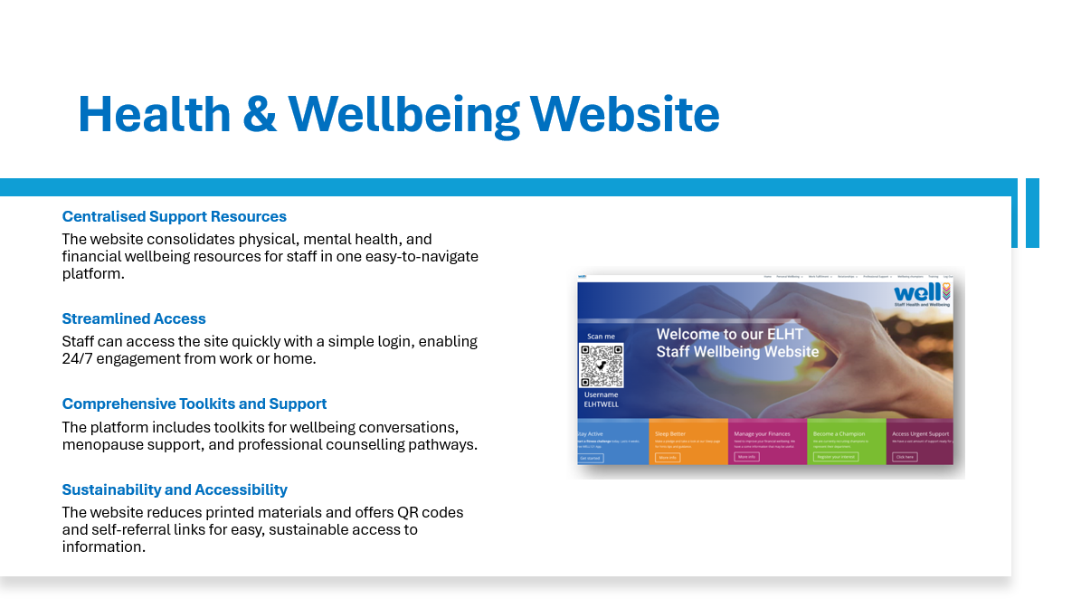
Scan me
Username
ELHTWELL
Website: Lscwellservice.co.uk
Username: ELHTWELL
LSCwellservice.co.uk - ELHTWELL
Notes:
To access your Health and Wellbeing website please visit: login - LSC Well Services
The username is: ELHTWELL

Slide 3
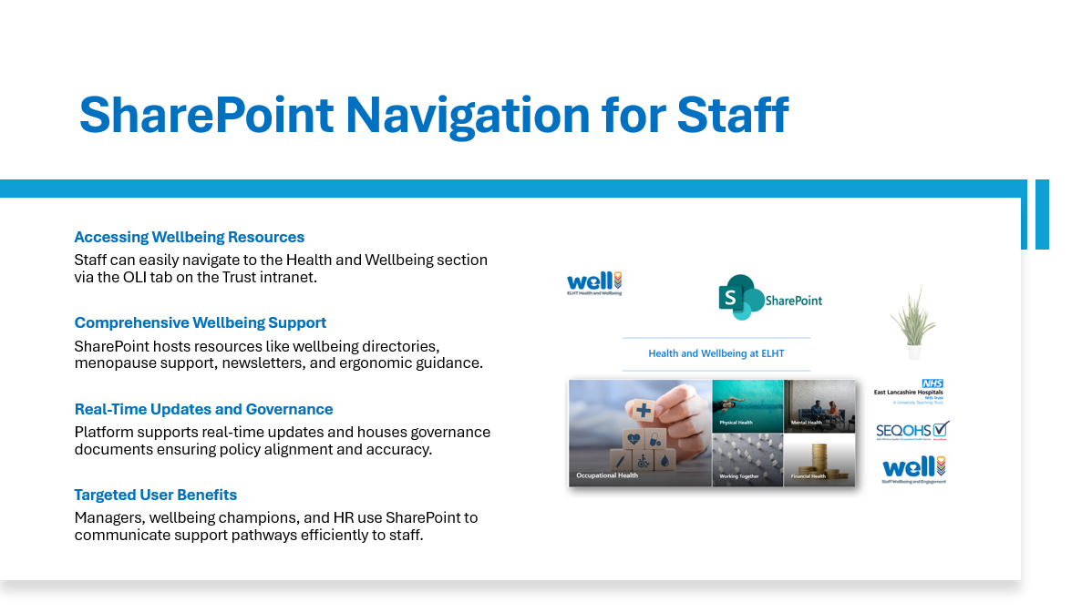
Notes:
To visit the Health and Wellbeing SharePoint page at ELHT, go to OLI on the Trust’s intranet. At the top of the screen, you’ll see several tabs, and Health and Wellbeing will be listed among them.
Welcome to our Occupational Health and Health & Wellbeing SharePoint

Slide 4
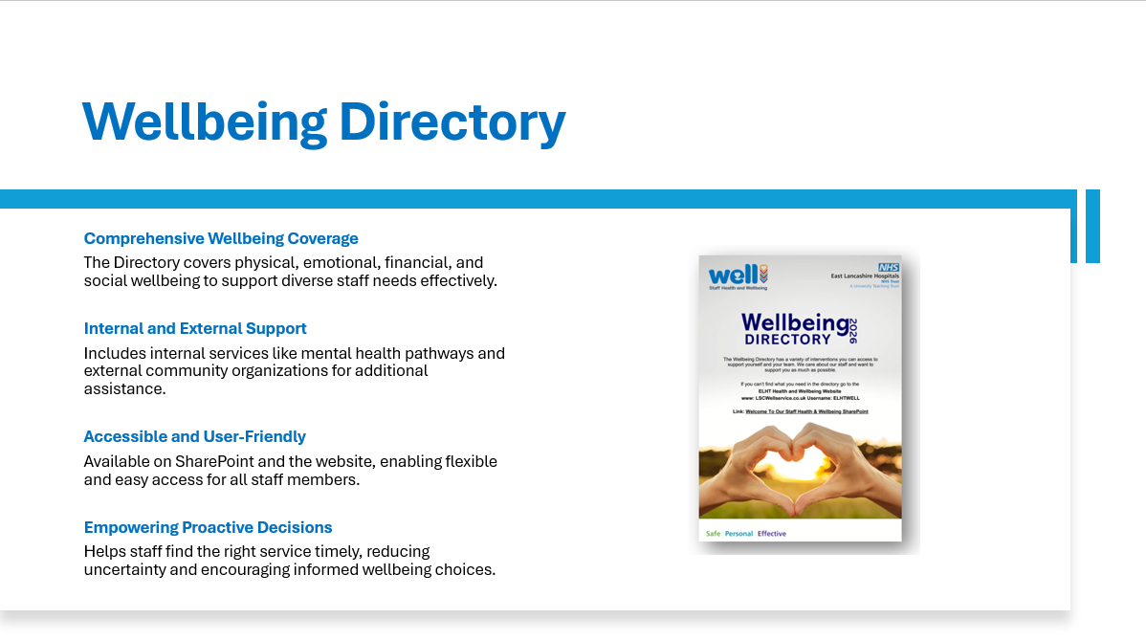
Notes:
The Directory can be downloaded from SharePoint or the Health and Wellbeing website, so people can access it however suits them.
Welcome to our Occupational Health and Health & Wellbeing SharePoint
To access your Health and Wellbeing website please visit: login - LSC Well Services
The username is: ELHTWELL

Slide 5
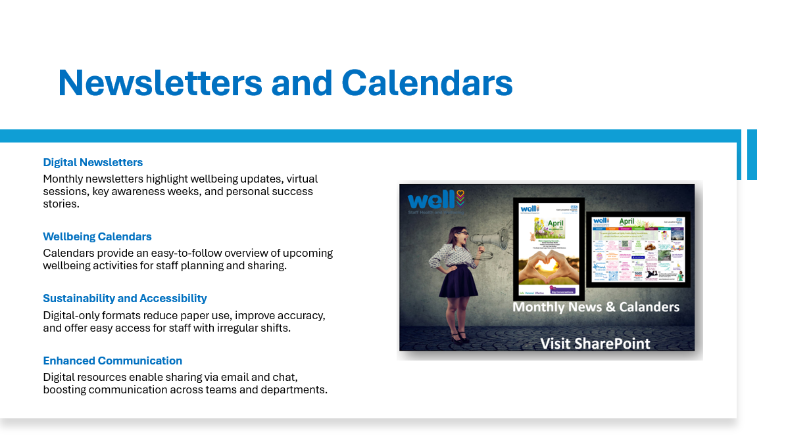
Monthly Newsletters & Calanders
LSCwellservice.co.uk - ELHTWELL
Notes:
Visit SharePoint or the Health and Wellbeing Website:
Welcome to our Occupational Health and Health & Wellbeing SharePoint
To access your Health and Wellbeing website please visit: login - LSC Well Services
The username is: ELHTWELL

Slide 6

Wellbeing & Engagement Champions
LSCwellservice.co.uk - ELHTWELL
Notes:
We now have more than 350 Champions across the Trust, all volunteering their time to support colleagues.
You can register using the link below or visiting the Wellbeing Champions section on the Health and Wellbeing Website.
Expression of Interest Form Wellbeing and Engagement Champion – Fill out form

Slide 7

Notes:
Wellbeing conversations and the Wellbeing and Adjustment Passport can be found under the “Relationships tab” on your health and wellbeing website:
To access your Health and Wellbeing website please visit: login - LSC Well Services
The username is: ELHTWELL

Slide 8

Notes:
Email: Wellteam@elht.nhs.uk
We’ll check our availability and get back to you.

Slide 9
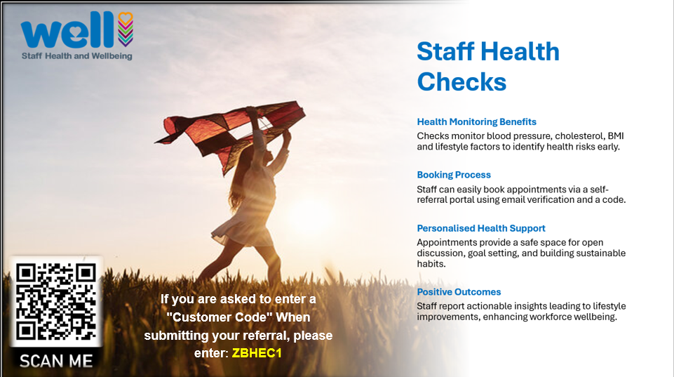
Notes:
Staff book through the self‑referral portal, using email verification and the ELHT code ZBHEC1. https://elht.opasg2.com/selfreferral
You can also email Occupationalhealth@elht.nhs.uk to book your appointment.

Slide 10
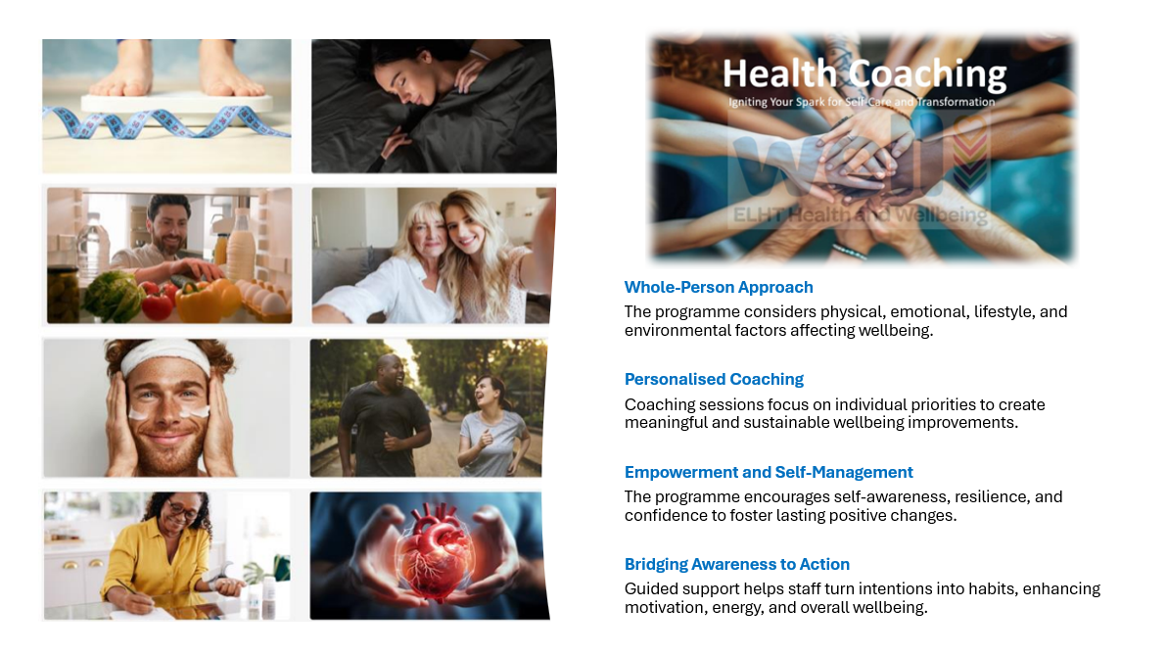
Notes:
The Health Coaching programme offers personalised, solution‑focused support for colleagues who want to improve their wellbeing in a meaningful and sustainable way.
It recognises that wellbeing isn’t just one thing.
Welcome to the Health Coaching Enquiry Form – Fill in form
"Igniting Your Spark for Self-Care and Transformation.”

Slide 11

Notes:
The process begins when a staff member completes the internal mental health enquiry form.
Once this is submitted, they’re invited for a wellbeing conversation with one of our wellbeing practitioners.
Mental Health Support - Enquiry Form – Fill in form

Slide 12

Notes:
You can access the EAP through the Professional Support tab on the Health and Wellbeing website.
Vivup Employee Assistance Programme (EAP)
Whatever mental health, physical, financial or personal issue you are facing, access expert help and support for life’s ups and downs, 24/7, 365 days a year.
To access a wide range of care and support specialists waiting to hear from you click on the link below.
Employee assistance programme
ELHT Code is: 103776
Confidential helpline
0800 023 9324

Slide 13



Aims
To reduce ELHT sickness absence and support you to stay in work
To improve the general wellbeing, fitness and health of staff
To assist employees with long standing health conditions to complete their jobs safely and effectively
To ensure workplaces are ergonomically sound to help prevent long term musculoskeletal problems​​​​​
Notes:
Please visit your health and wellbeing website: login - LSC Well Services
The username is: ELHTWELL
Then select the “Professional Support” tab, then select Fast Physio PAL for the referral form and further details.

Slide 14

Notes:
You can find all available sessions under the “Training” tab on the Health and Wellbeing website.
To access your Health and Wellbeing website please visit: login - LSC Well Services
The username is: ELHTWELL

Slide 15
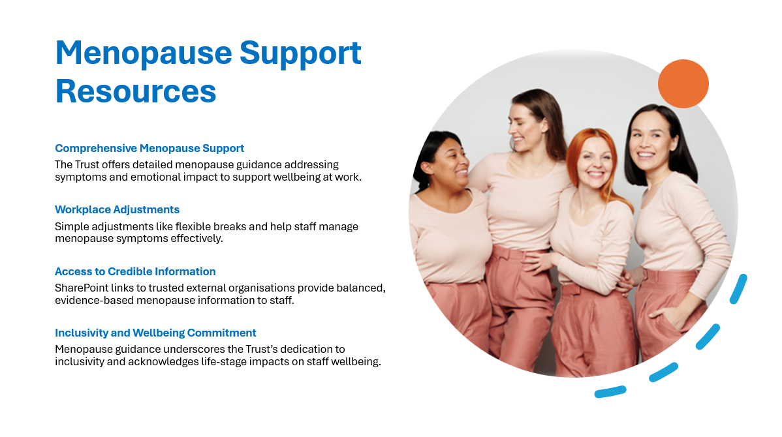
Notes:
Staff can access clear guidance on SharePoint, including information on common symptoms, myths, practical tips for managing menopause at work and advice on when to speak to a GP.
Welcome to our Occupational Health and Health & Wellbeing SharePoint

Slide 16
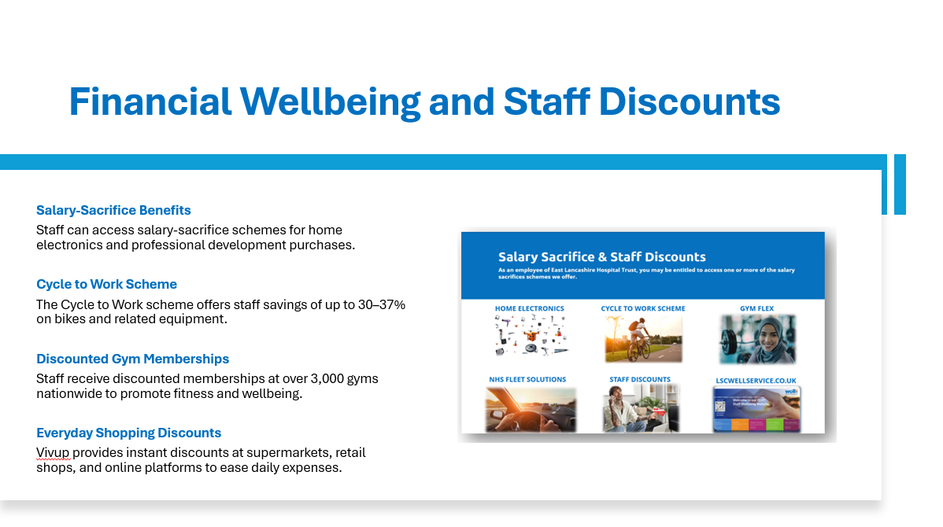
Notes:
Vivup offers a wide range of discounts on home and electronic goods.
Visit the Financial Wellbeing section under the tab “Personal Wellbeing” on your health and wellbeing website:
To access your Health and Wellbeing website please visit: login - LSC Well Services
The username is: ELHTWELL

Slide 17

Notes:
Email: gymenquiries@elht.nhs.uk

Slide 18

Occupationalhealthservices@elht.nhs.uk
Notes:
Occupational Health and Wellbeing operates from 8:00am to 4:00pm at Park View Offices, Level One, making it easy for most staff to access support.
Email: Occupationalhealthservices@elht.nhs.uk
Providing:
Blood tests, health screening and immunisations
Emergency walk‑in support for needlestick, sharp and splash incidents
Fair, supportive guidance for staff and managers around sickness absence and fitness to work
Advice on workplace adjustments for disability, illness or injury
Lifestyle, stress, general health and wellbeing advice
Fast Physio
Work Smart
And much more!

Slide 19


Any Questions please email:
Wellteam@elht.nhs.uk
Occupationalhealthservices@elht.nhs.uk
LSCwellservice.co.uk - ELHTWELL

